Slide 1
Baifern,
Non,
Golf,
Winz
1201 int.

Slide 2
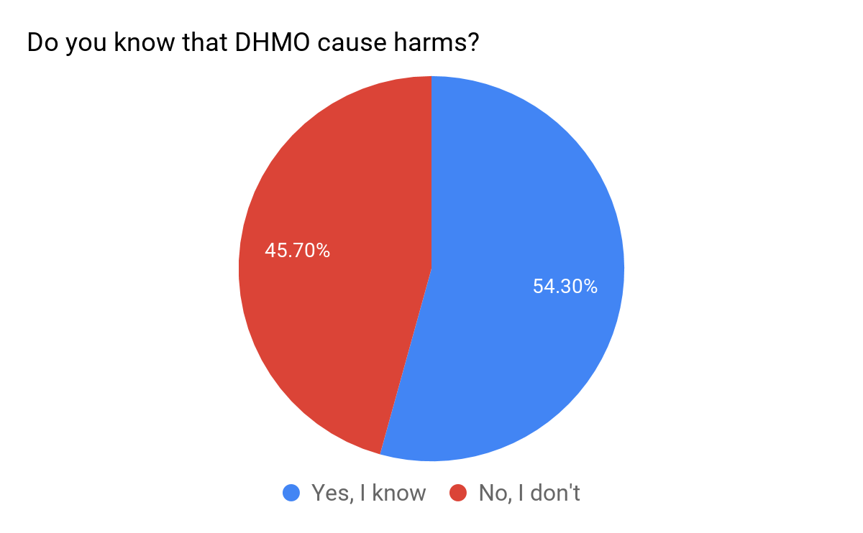

Slide 3
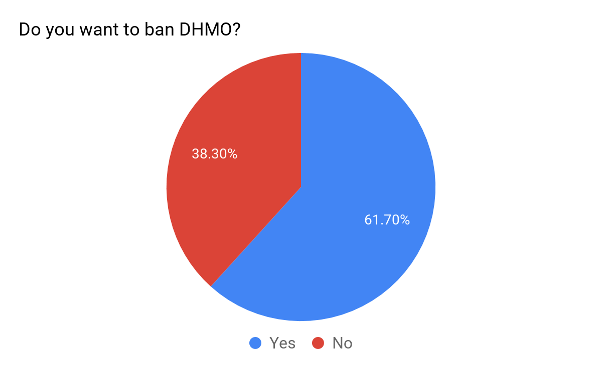

Slide 4
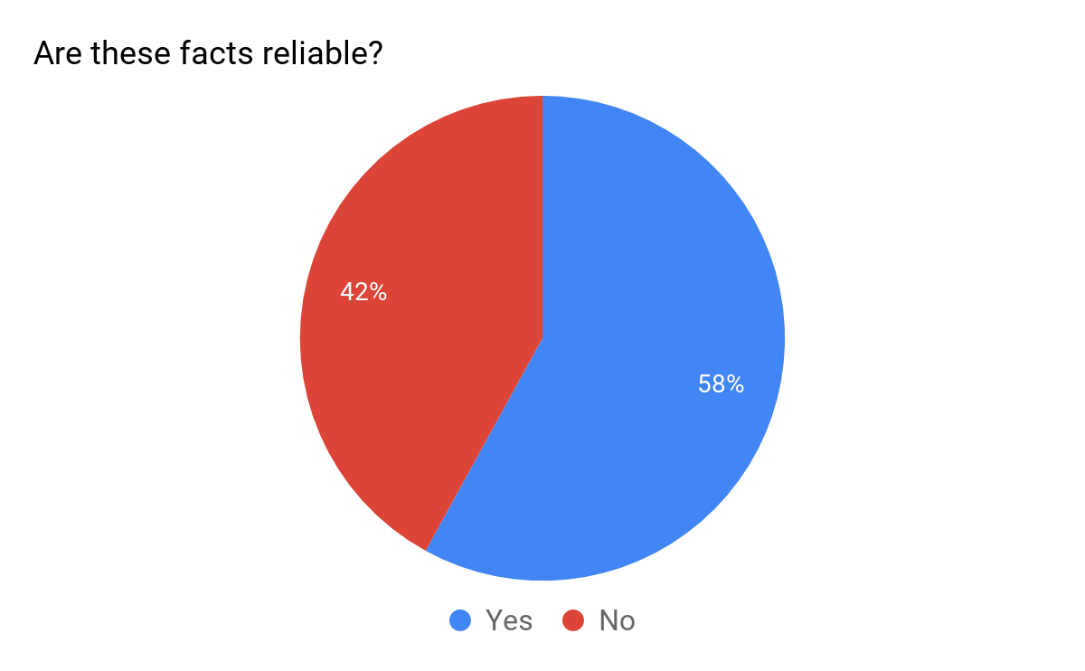

Slide 5
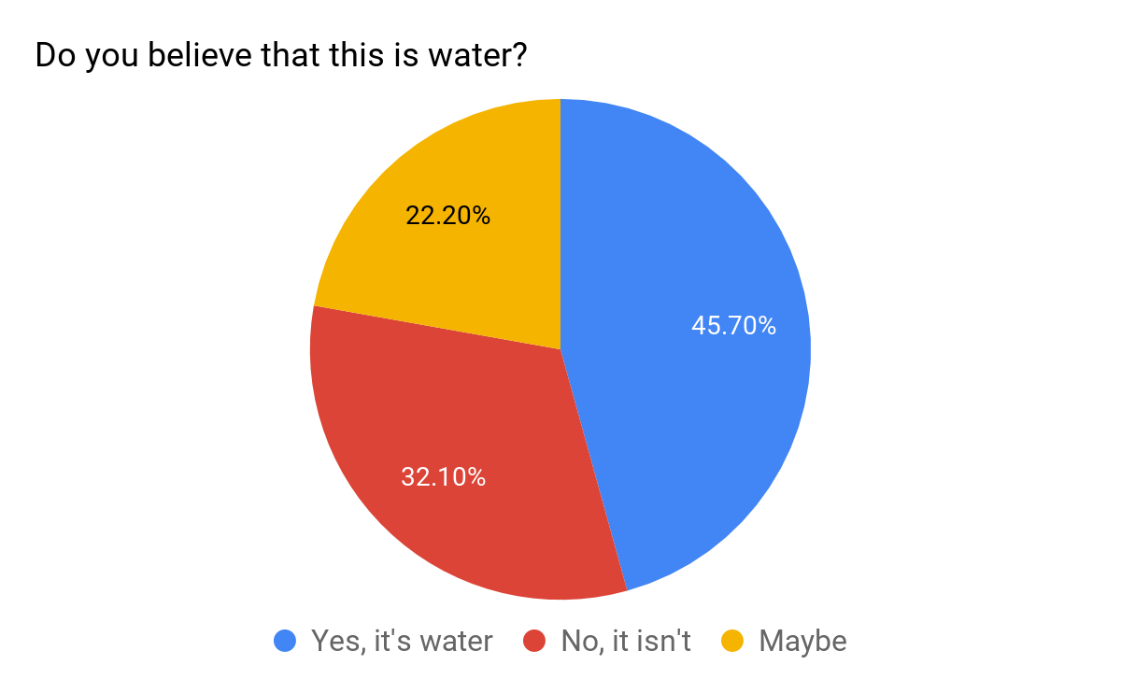

Slide 6
Analysis
Based on the survey, 54.3% (44 students) of students thought that DHMO is harmful, while 45.7% (37 students) disagreed. However, number of students who wanted to ban DHMO is more than number of the students who said it’s harmful, 51.7% (50 students), because students who did not think it causes harm wanted to ban it.
However, 39 students (42%) did not believe that the facts are reliable and 45.7% of students (37 students) believe DHMO is water, while 32.1% disagreed and the rest felt not sure.

Slide 7
Conclusion
From the pie graphs, most students response in negative feeling toward Dihydrogen Monoxide (DHMO) due to what they have heard from the information, which 58% of them think it’s reliable.

